Slide 1
Secure Web Programming
Lecture 1. Fundamental concepts
Amanda.Lunt@utas.edu.au
Soonja.Yeom@utas.edu.au

Slide 2
Topics
Secure Web Programming
Week13
Review
Basic Web Programming
Web Security
Adv. Web Programming
Fundamentals – protocol, CS model, etc.
HTTP Protocols, Storage
Advanced Web Applications
Human Computer Interaction with Web Page Design
Security Issues and Technologies
Session management
Client-side Scripting Language and Document Object Model
Secure Programming and Users
Common Gateway Interface
Server-side Scripting Language and Privilege configuration
Encryption and Authentication
Advanced Security Issues

Slide 3



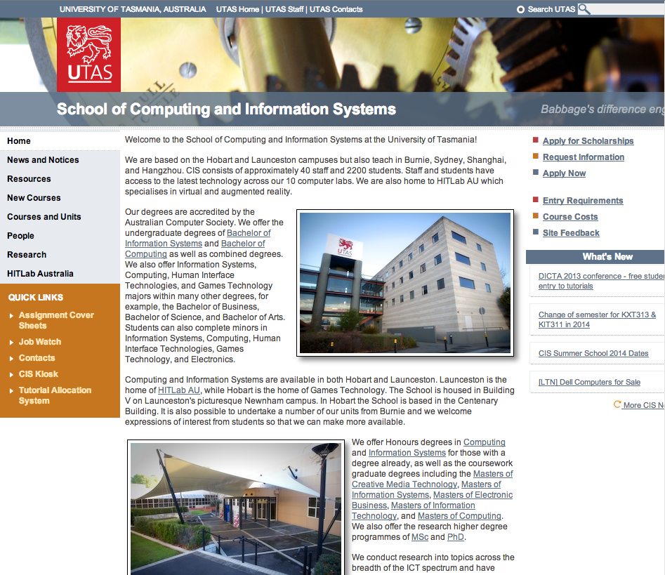
Background concept
http://www.cis.utas.edu.au
It is “131.217.34.13”
INTERNET
Request: “Could you send me the content?”
What is the IP address of “http://www.cis.utas.edu.au”?
1
2
2
Domain Name Server
Response: “Here you go”
3
Site A Host
4
Site B Host
CIS Host

Slide 4
Internet
What is the Internet?
The computer network, which allows computer users to connect with computers all over the world (Collins Dictionary)
A global computer network providing a variety of information and communication facilities, consisting of interconnected networks using standardized communication protocols (Oxford Dictionary)
A global system of interconnected computer networks that uses the TCP/IP network protocols to facilitate data transmission (Wikipedia)
Summary: “Internet” is a huge worldwide communication system,
which connects computers using the TCP/IP network protocols
to facilitate data transmission

Slide 5

Protocol
Agreed set of rules, which determine how data should be transmitted in telecommunications computer networking
Example Protocols
HTTP - logical connection between www applications
TCP/UDP – logical connection between processes running on hosts
IP – physical (sort of) connection between hosts
http://www.cis.utas.edu.au

Slide 6
TCP/IP Protocol
TCP/IP (Transmission Control Protocol/ Internet Protocol)
the basic communication protocol of the internet or similar network
supports data transmission on the internet

Slide 7
TCP/IP Protocol Suite
Internet => uses TCP/IP Protocol Suite
Application Layer
TELNET, FTP, SMTP, POP, HTTP, …
NFS, RPC, TFTP, …
DNS
SNMP
Transport Layer
TCP
UDP
Internet Layer
IP and ICMP
ARP
Data Link Layer
Ethernet
Physical Layer
Link and Physical

Slide 8
TCP/IP Protocol Suite
Internet => uses TCP/IP Protocol Suite
Application Layer
Concerned with differences in internal representation, user interfaces, and anything else that the user requires
Transport Layer
Concerned with process-to-process delivery of information
Internetwork Layer
Delivers data in the form of a packet from source to dest., across as many links as necessary, to non-adjacent systems
Data Link Layer
Organises the bit stream into a data unit called a “frame” and delivers the frame to an adjacent system
Physical Layer
Contains all the functions needed to carry to bit stream over a physical medium to another system

Slide 9

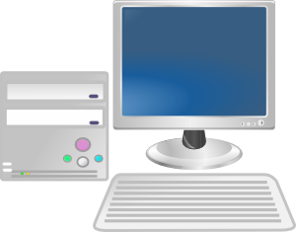
Data Transmission over the Internet
Sender A
Receiver B
Application
Application data (HTTP, SMTP..)
Application
Transport
TCP Header
TCP data
Transport
Internetwork
IP Header
IP Data
Internetwork
Link
Ethernet Header
Ethernet Data
Ethernet Trailer
Link
Physical Layer
1001001010001001010010 …
Physical Layer
Physical Communication Links (incl. Cable, Fiberglass)

Slide 10
Internet Services and Protocol
Email service
SMTP: Simple Mail Transfer Protocol
POP: Post Office Protocol
File Transfer Service
FTP: File Transfer Protocol
World Wide Web Service
HTTP (Hypertext Transfer Protocol)
http://www.cis.utas.edu.au

Slide 11
HyperText Transfer Protocol (HTTP)
The Application Protocol for hypermedia information systems
What is a Hypertext?
Hypertext is structured text that uses logical links between nodes containing text
School of Computing at UTAS
University of Tasmania is located in Tasmania, Australia
Liz Taylor is an academic at UTAS
KIT502 is a Web Programming Unit
Tasmania is an island state, part of Australia
Australia is country, comprising the mainland and Tasmania
Soonja teaches KIT502. She is staff in University of Tasmania
List of Web programming unit
KIT202
KIT405
KIT502

Slide 12
Serving Web pages (Hypertext pages) using HTTP
http://www.cis.utas.edu.au
INTERNET
Request: “Could you send me the content?”
Domain Name Server
Request
Response: “Here you go”
Site A Host
Web Client
Response
Site B Host
CIS Host
Web Servers

Slide 13
Serving Web pages (Hypertext pages) using HTTP
http://www.cis.utas.edu.au
HTTP request message
Request: “Could you send me the content?”
Response: “Here you go”
HTTP Response message
Web Client
CIS Host
Web Servers

Slide 14
HTTP messages
Text messages with a set format –contain all of the communication between client and server
Request message (sent by client)
Response message (sent by server)
Message structure is same for both request and response.

Slide 15
HTTP messages
17
Request message
Response message
Called the request line – 3 parts
Method (e.g. GET, POST)
Uri of request resource
HTTP version being used
Initial Line
Called the status line – 3 parts
HTTP version
Response code
Response phrase
Contain information that allows the client to:
Provide information about itself to the server
Give additional details about the nature of the request that the client is making
Allow the client to have greater control over how its request is proceed and how a response is returned by the server or intermediary
Headers
Contain information about such things as:
the media type of the content sent to the recipient
a new URL that the server is instructing the client to use in place of the one the client initially requested
cookies that the client should store
Blank Line
May contain data that has been submitted from a form
Optional Contents
The actual contents of the resource requested (e.g. the html code)

Slide 16
Components of a Dynamic Web page (1)
There are 3 key components of web page, when writing pages, these components should be kept as separate as possible
The semantic structure of the web page
The appearance of the web page
The behaviour of the web page

Slide 17
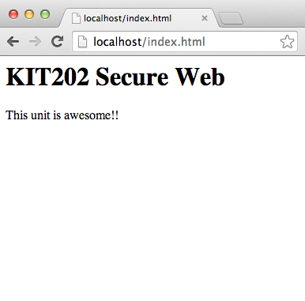
The semantic structure of the web page
The semantic structure of the page
Define the structure and layout of a Webpage
Mostly implemented in HTML (Hyper Text Mark-up Language)
<html>
<body>
<div id=“header”>
<h1> KIT202 Secure Web </h1>
</div>
<div id=“main content”>
<p> This unit is awesome!! </p>
</div>
</body>
</html>
File : index.html
Output of “index.html” in Chrome

Slide 18
Hyper-Text Markup Language (HTML)
Hyper-Text Markup Language (HTML)
Predominant markup language for Web pages
Uses markup tags to describe web pages
basic building blocks of webpages
Allows images and objects to be embedded
Markup language
Traditional method in printing industry
Format: <name> content </name>
A set of markup tags, publishing information for contents

Slide 19
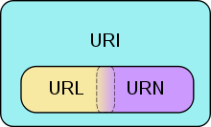
Hyper-Text Markup Language (HTML)
Uniform Resource Locator (URL)
Location of resources,
Retrieval methods
Uniform Resource Name (URN)
URI using urn schema (RFC1737)
Used for identification
Uniform Resource Identifier (URI)
Identify a name or resource
Used for identification
NOTE: While URL is widely used in many places, the standard technical document published by W3C normally use only URI instead of URL.

Slide 20
The history of HTML
HTML versions Timeline
Year | Version
1991 | HTML
1994 | HTML2
1997 | HTML3, HTML4
2000 | XHTML1
2009 | HTML5
2016 | HTML5.1* (standard as of Nov 2016)

Slide 21
Components of a Dynamic Web page (2)
There are 3 key components of web page, when writing pages, these components should be kept as separate as possible
The semantic structure of the web page
The appearance of the web page
The behaviour of the web page

Slide 22
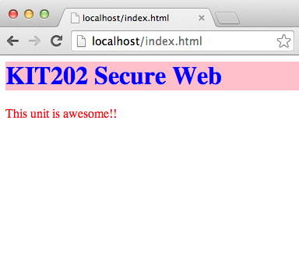
The Appearance of the web page
The Appearance of the web page
Mostly implemented in CSS (Cascading Style Sheets) – External style as below
<html>
<head>
<link rel=“stylesheet” href=“style.css”>
</head>
<body>
#header{background-color:pink;}
h1{color:blue;}
p{color:red;}
+
<div id=“header”>
<h1> KIT202 Secure Web </h1>
</div>
<div id=“main content”>
File : style.css
<p> This unit is awesome!! </p>
</div>
</body>
</html>
File : index.html
Output of “index.html” in Chrome

Slide 23
Cascading Style Sheets
There are three ways to apply cascading style sheets on the web page
External Style Sheet – Recommended
Have external CSS file, and link it to HTML file
Internal Style Sheet
Put the style sheet in the HTML file (head section)
Inline Styles
using ‘style’ attribute with HTML tag

Slide 24
Components of a Dynamic Web page (3)
There are 3 key components of web page, when writing pages, these components should be kept as separate as possible
The semantic structure of the web page
The appearance of the web page
The behaviour of the web page

Slide 25
The Behaviour of the web page
The behaviour of the web page
implemented using client side scripting
Common client-side script language
JavaScript, VBScript and etc.
NOTE: A page with client-side scripting can be "dynamic" from the users point of view BUT it fits the "serving static web page" model because the code has been prewritten and stored on the server

Slide 26
Client-side Scripting
Client-side Scripting
Programs on the web that are executed client-side, by the user’s web browser
often can be executed without further communications with the server
Have greater access to the information and functions available on the user’s browser than server-side
Often embedded within an HTML document
The necessary codes are sent to the user’s computer.
Require that the user’s web browser understands the scripting language in which they are written

Slide 27

Static Web Page
a web page that is delivered to the user exactly as stored
often HTML documents stored as files in the file system
displays the same information for all users
HTTP request message
HTTP Response message
Client Computer (Browser)
Web Server
Static Web Page Request-Response Process

Slide 28

Dynamic Web Page
generated by a web application (scripting languages)
can customize the response on the server to offer personalization
can be changed in response to different contexts or conditions
HTTP Response message
Application Server
HTTP request message
Client Computer (Browser)
Web Server
Database
Dynamic Web Page Request-Response Process

Slide 29
Server-side scripting
Server-side scripting
Executed by the web server when user request a document
produce output in a format understandable by web browsers
Require that their languages interpreter be installed on the server
produce the same output regardless of the client’s browser
Common server-side script language
PHP, ASP.NET, Perl, JSP and etc.

Slide 30
Web Applications
Web application
an application that can be accessed over a network such as the internet
a computer software application that is hosted in a browser-controlled environment
contents on the web client interacting with human actions
a computer software application that is hosted in a Web server-controlled environment
Contents from the server are generated by the software in the Web-Server.
Common web applications
Web mail
online auctions

Slide 31
Benefits of Web Applications
There are several benefits of using the web application :
no upgrade procedure
All new features are implemented on the server and automatically delivered to the users.
cross-platform compatibility
Web applications operate within a web browser window.
Easy to integrate into other web applications

Slide 32
Thank you
Any Questions

